Slide 1
Creating Drupal 8 Sites on SiteGround
SiteGrounIT 320 - Intro to Drupal 8d Web Host

Slide 2
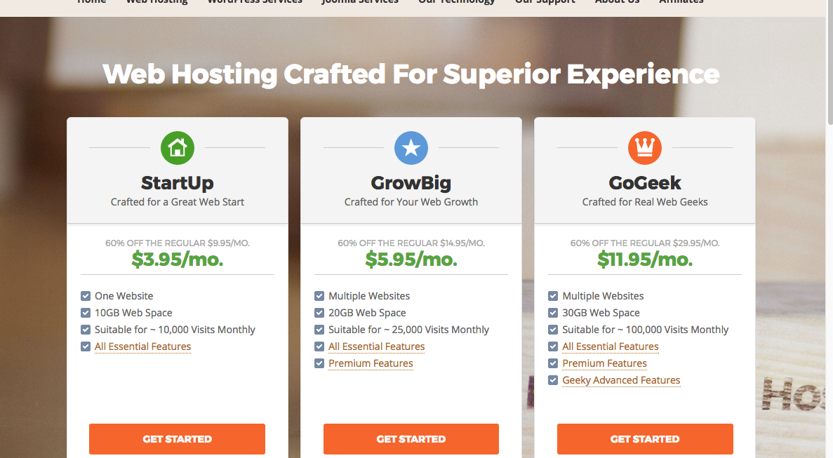
SiteGround Shared Web Host Account Costs

Slide 3
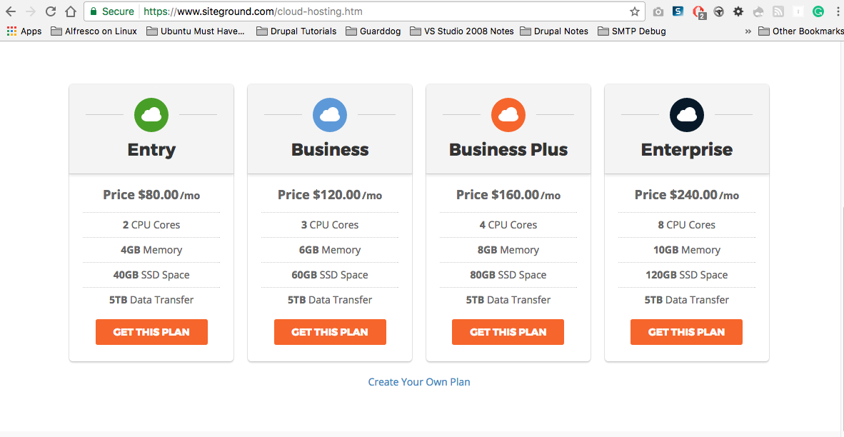
SiteGround Cloud Hosting Costs

Slide 4
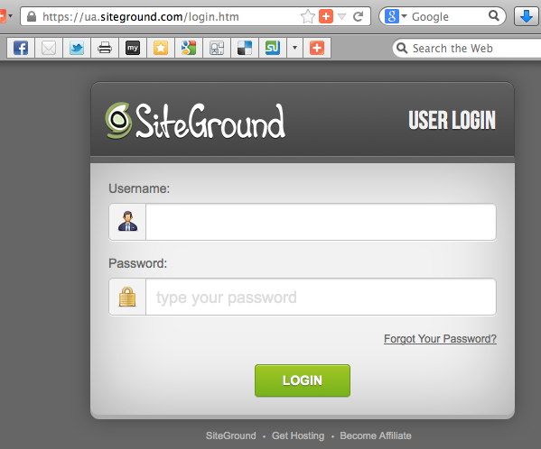
Access SiteGround & Login

Slide 5
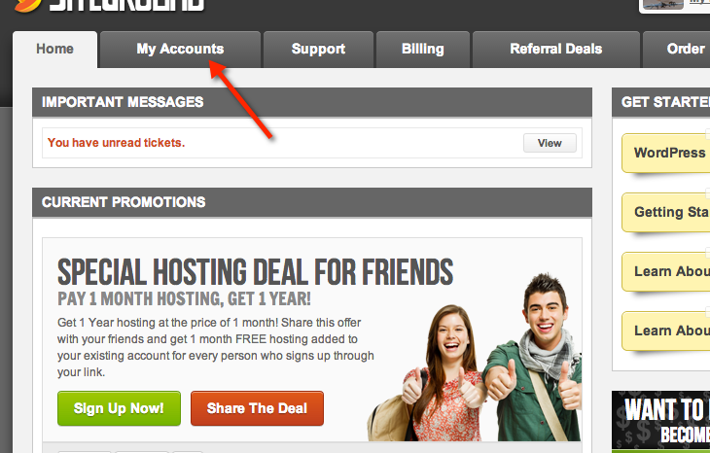
Access SiteGround, Select My Accounts

Slide 6
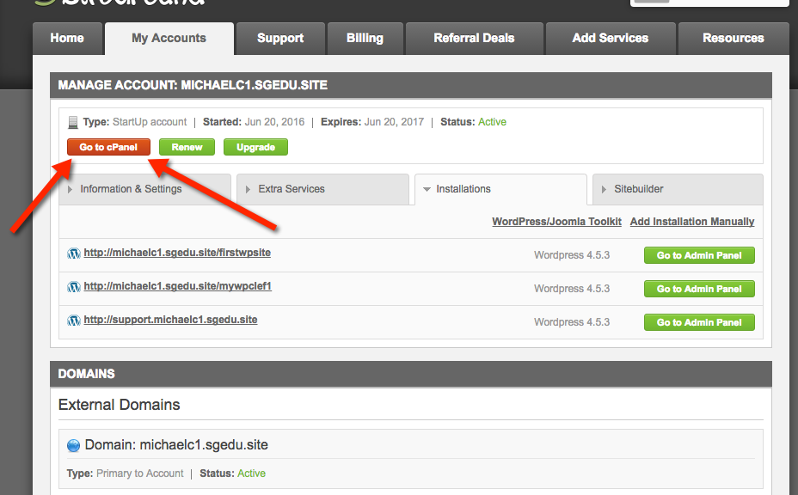
Select “Go to cPanel” button

Slide 7
Note About the Drupal Build Scripts
The Softaculous Drupal build scripts have a hard coded email value of “admin” at your domain.
To prevent any Drupal Email issues, we should check that an “admin” email account exists on our shared Web Host and if it doesn’t exists, create one

Slide 8
Note About the Drupal Build Scripts
The Softaculous Drupal build scripts have a hard coded email value of “admin” at your domain.
If my domain is [michaelc1.sgedu.site] then the Drupal build script lists [admin@michaelc1.sgedu.site] on the build settings page.
If my domain account does not have an email account for admin@michaelc1.sgedu.site my Drupal site will not send emails correctly
Also – adding the email account after the fact may not fix the problem
To prevent any Drupal Email issues, check for an “admin” email account and create one if it does not exist

Slide 9
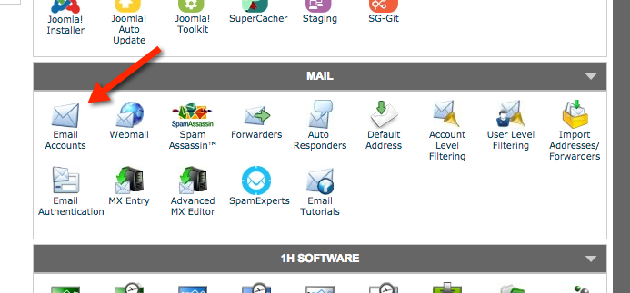
Access Email Account Manager through cPanel

Slide 10
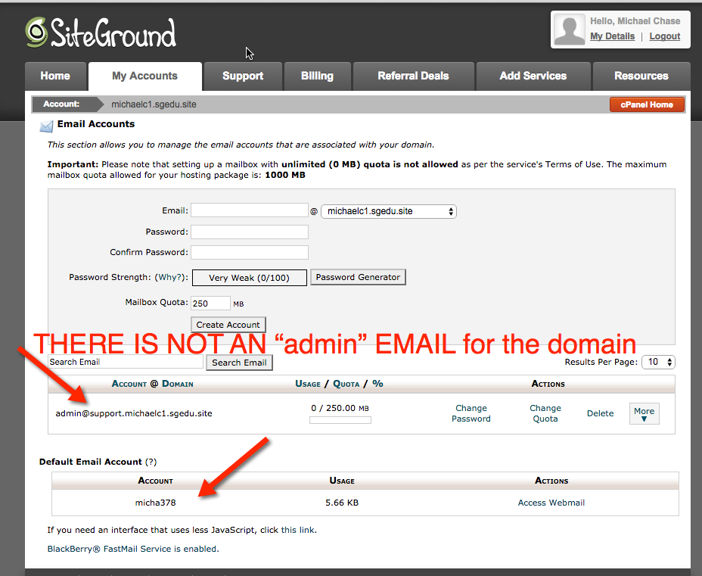
Is there an “admin” email account for the domain? ANSWER: No. There is a subdomain email account admin@support.michaelc1.sgedu.site but no account for admin@michaelc1.sgedu.site

Slide 11
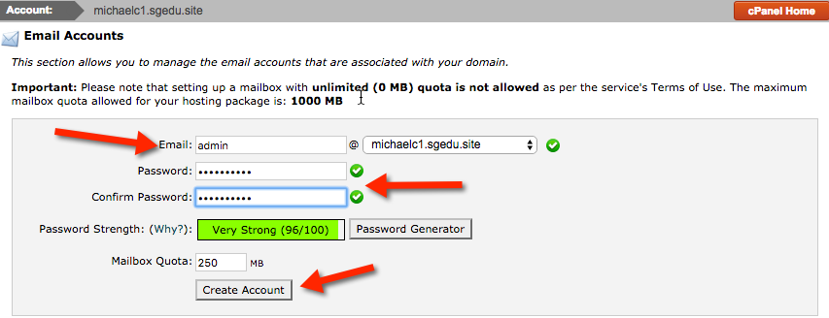
Create Email Account for admin @ webhost domain my domain is michaelc1@sgedu.site

Slide 12
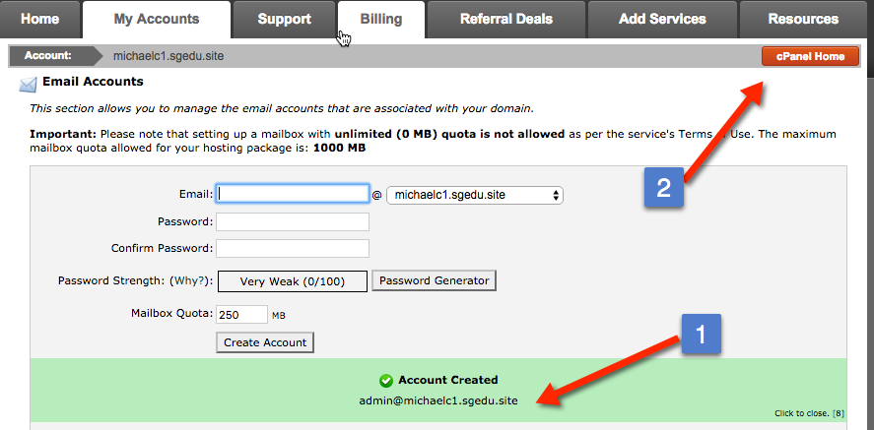
(1) Verify Success Message (2) Return to cPanel to build a Drupal site

Slide 13
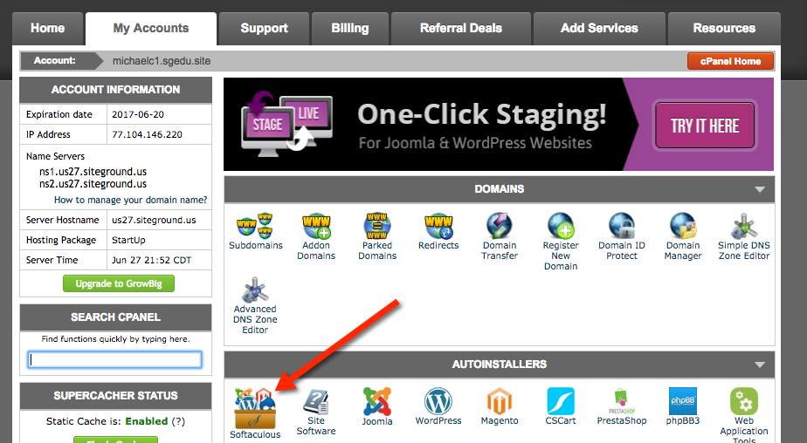
Scroll down to the AUTOINSTALLERS section

Slide 14
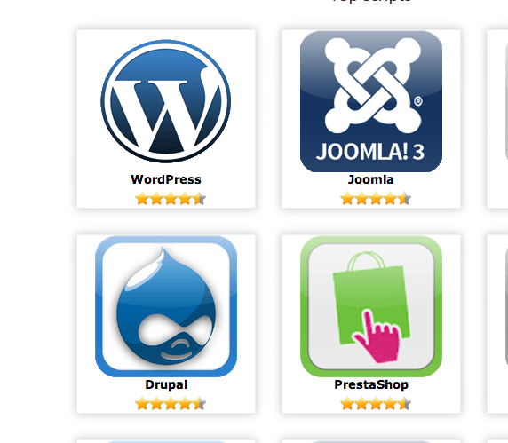
If the Drupal icon EXISTS Hover Over it

Slide 15
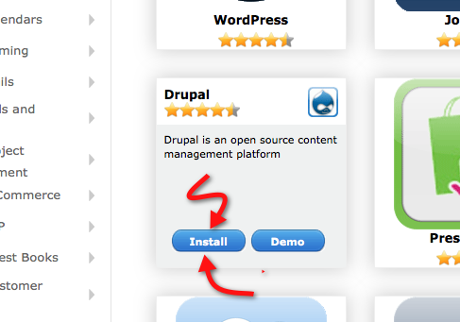
Then select the Install button

Slide 16
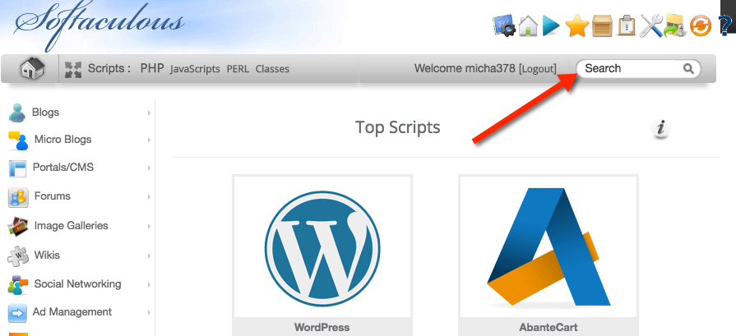
If the Drupal Icon does not EXIST Enter Drupal in the Search widget

Slide 17

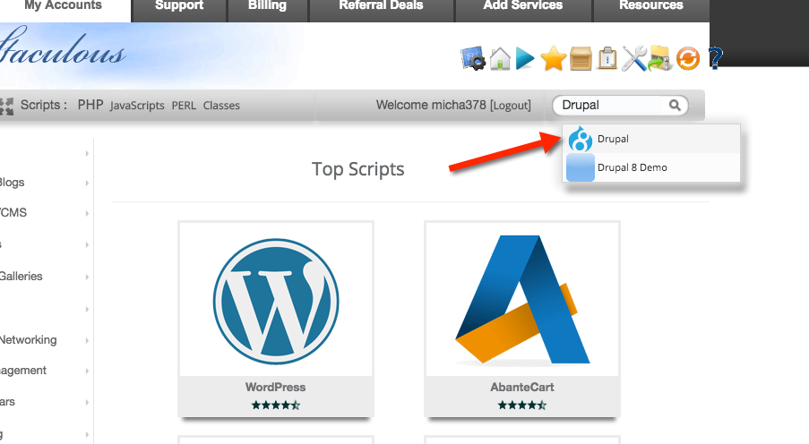
Select the Drupal 8 icon

Slide 18
Fill Out the The Software Setup Form
We will create ‘In Directory’ Drupal 8 sites
‘In Directory’ names are all lowercase
‘In Directory’ names are unique on the Web Host
To re-use an in directory, first delete the existing site, then re-create a new site reusing the directory name
Record the database name
Use a secure admin user name and password
Record the user name and password
If you don’t have an admin email account on your webhost, STOP! Do not create the site.

Slide 19
Best Practices For Creating Drupal Sites
Do not (as in never) create a Drupal site without a database table prefix of at least three letters and an underscore
Never remove the database prefix or its underscore
When trying out a new contrib. module or JavaScript library, never try it out on a production site
Always create a fresh test site and use the fresh test site for experiments
Always backup your site before implementing new “un-tested” in production modules or libraries.
Even if you tested on a test site, have a backup ready, just in case.

Slide 20
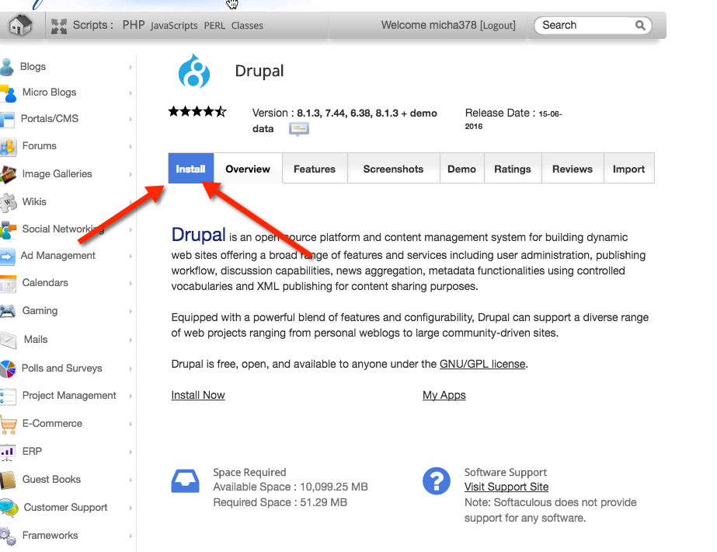
Select the Install link

Slide 21
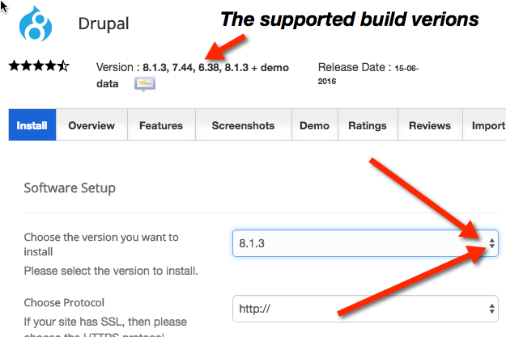
Now its decision time We want to build a Drupal 8 site Select the version dropdown 8.x (Where x is the most current version)

Slide 22
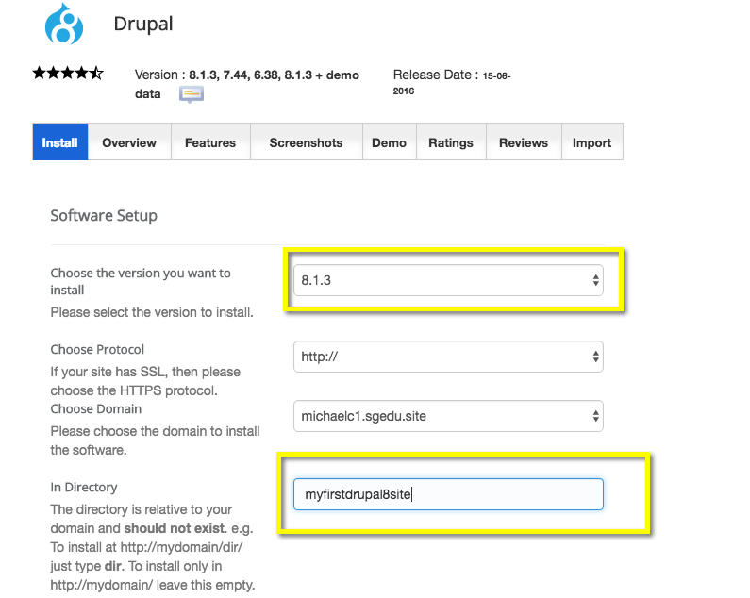
Create a Drupal 8 site – Enter a D8 version, Enter the In Directory name

Slide 23
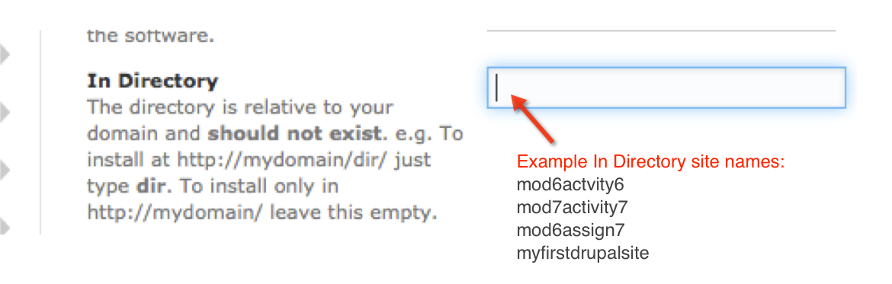
In Directory must be all lower case with no embedded spaces This example: myfristdrupal8site

Slide 24
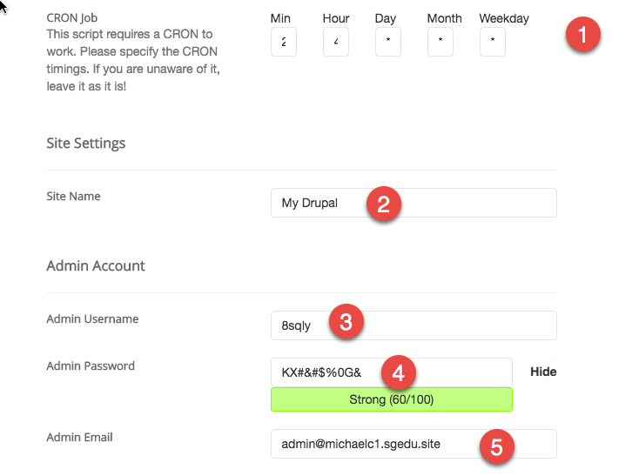
(1) Keep the default CRON settings – Mine are 2 4 * * * (DO NOT CHANGE CRON) (2) The Site Name

Slide 25
(1) CRON – see previous slide
CRON Job Your Drupal CMS requires a CRON to work properly. Please keep default CRON settings. Please do not remove CRON Settings (Removing will break your Drupal site)
General Rule for any Drupal setting:
If you are unaware of what it is for or does, leave it as it is (the default) until you understand it.
It appears that the FREE 1 Year student account CRON settings change with each Drupal site build.
Do not be surprised if your Drupal CROM settings are different than the ones shown in class presentations and training videos

Slide 26
What Is CRON ?
CRON is a time-based job scheduler in Unix-like computer operating systems. The name come from the word “chronos”, Greek for time
Drupal uses CRON to rebuild site pages (the content) on a scheduled basis. CRON is the timer mechanism.

Slide 27
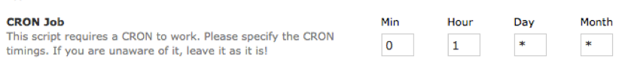
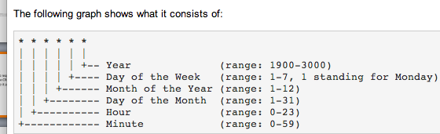
CRON Time Format Settings
Notes:
http://www.nncron.ru/help/EN/working/cron-format.htm

Slide 28
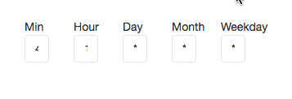
Translating CRON Time Settings
What it means
CRON SETTINGS ON FORM
Every 4 minutes after the hour of every day of every month of every weekday run the CRON job to rebuild the Drupal site

Slide 29
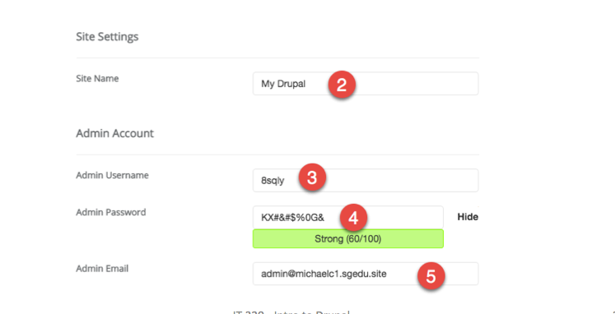
(2) Enter the Site Name (Mixed Case & Spaces are FINE) (3) Enter the Site Administrator Username (RECORD this somewhere) (4) Enter password (at least 60/100 strong) (RECORD this somewhere) (5) Make sure this admin email account exists on the web host before creating the Drupal site

Slide 30
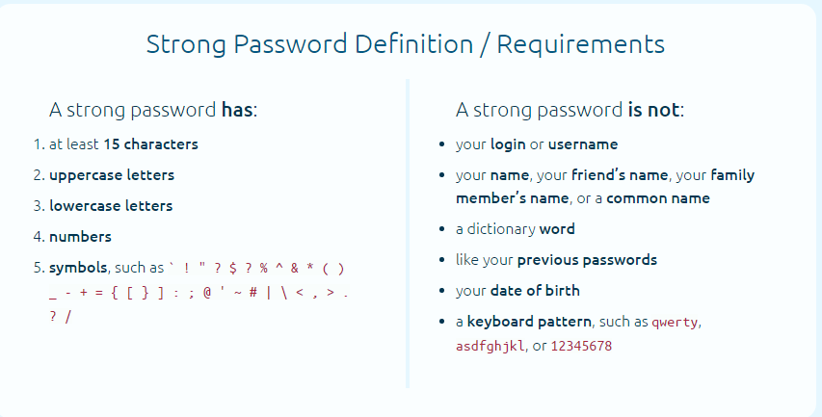
What are the attributes of a strong password? Source: https://strongpasswordgenerator.com/

Slide 31
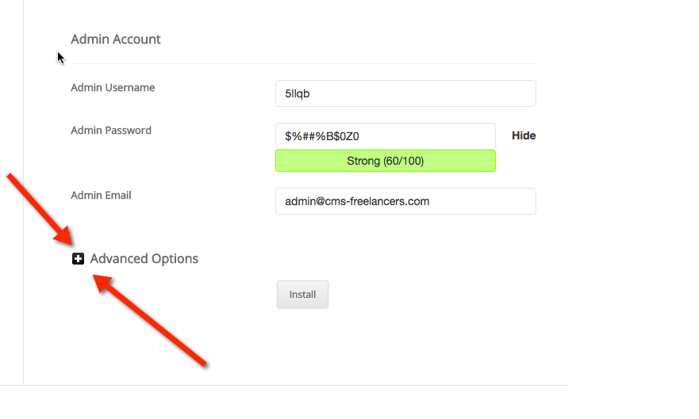
(6) Select the (+) to expand the Advanced Options section

Slide 32
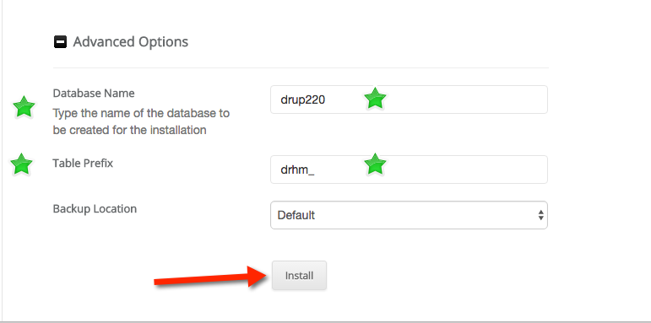
Record the database name and prefix then press the Install button to build the site

Slide 33
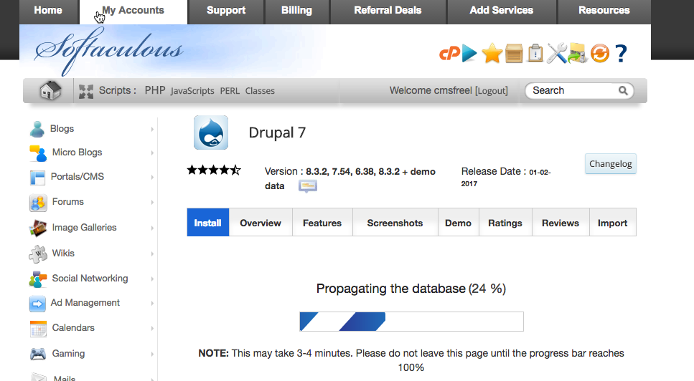
SiteGround Building your Drupal 8 site

Slide 34
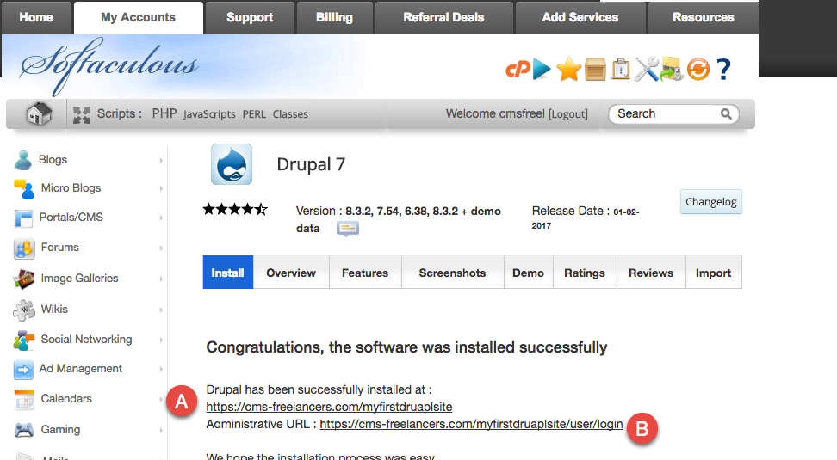
When SiteGround Complete the site build it displays this congratulations page with (A) front end and (B) back end site links

Slide 35
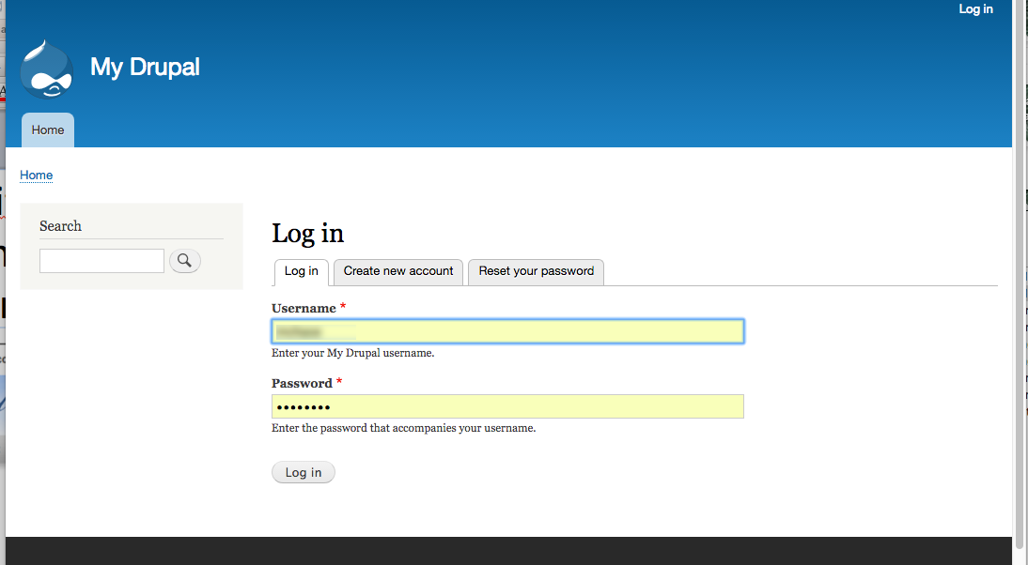
Select the backend link and login to your site

Slide 36
After Created a Drupal 8 site, immediately harden it – to protect it
We want to prevent anonymous users from requesting new Drupal accounts
We do this by changing the Drupal sites configuration settings to only allow Administrators to create new accounts
This is for this class only and only for our test sites

Slide 37
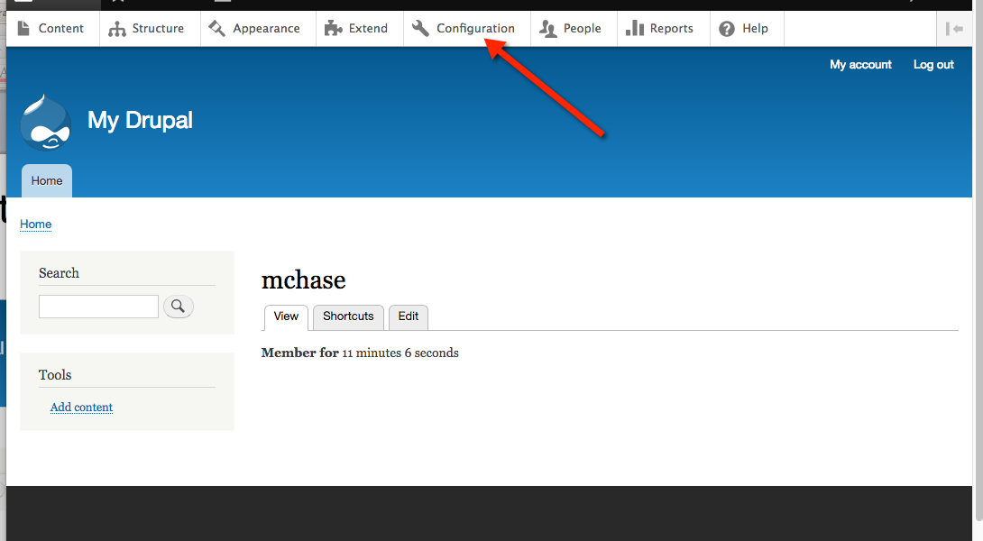
Select the Configuration Link

Slide 38
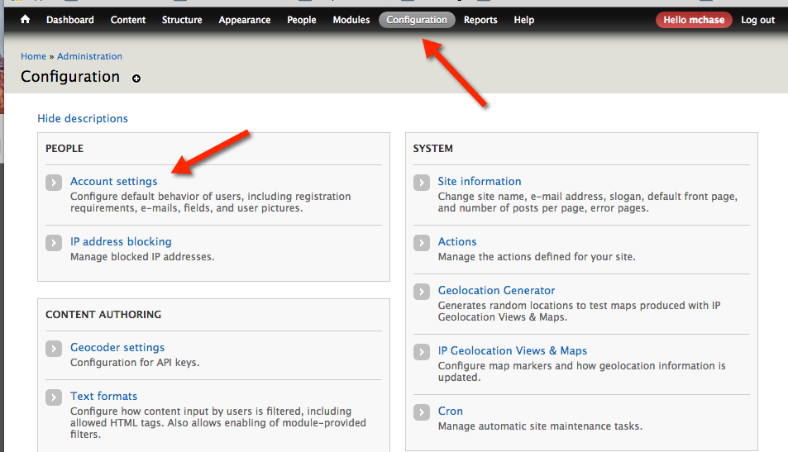
Harden Drupal 7 Sites Select Admin tool bar, Configuration > Account settings

Slide 39
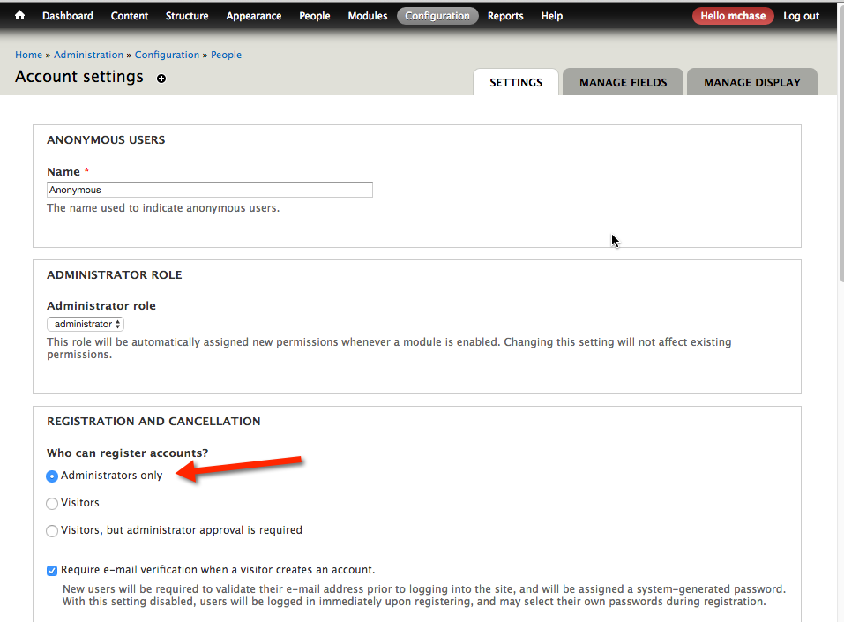
Change Registration and Cancelation to Administrators only

Slide 40
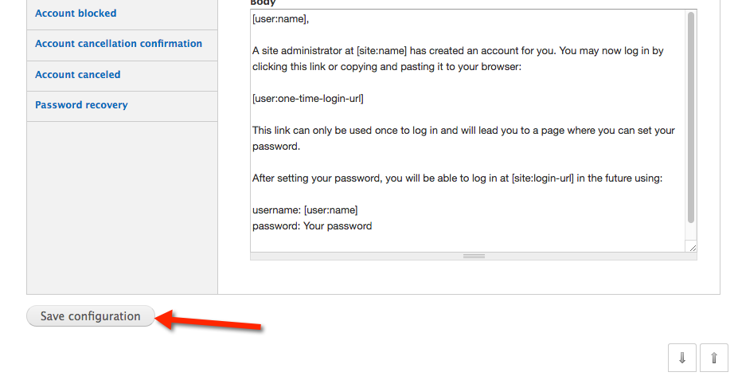
Scroll to the bottom of the Account settings page and press “Save configuration”

Slide 41
Drupal 8 (D8) vs. Drupal 7 (D7) Build
As far as the build, there is very little difference between building a Drupal 7 (D7) or a Drupal 8 (D8) site
Both builds generate a build notification page, and unless you disable update notifications (in Advanced options), both generate build notification emails
The real difference is in the managing and extending the Drupal site D7 vs. D8

Slide 42
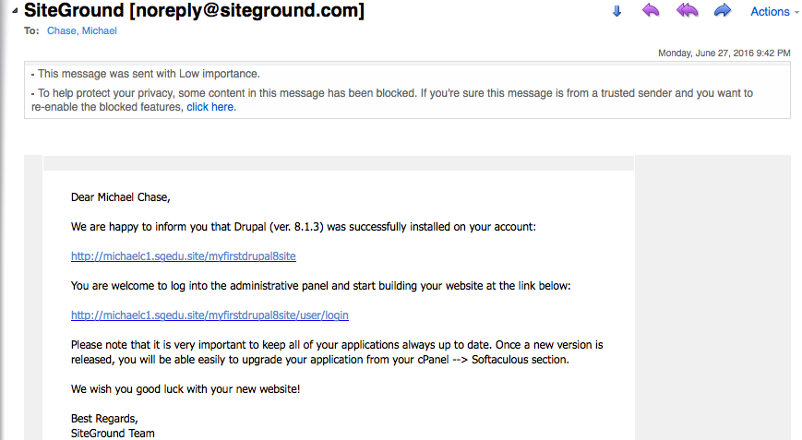
SiteGround Drupal 8 Notification Email

Slide 43
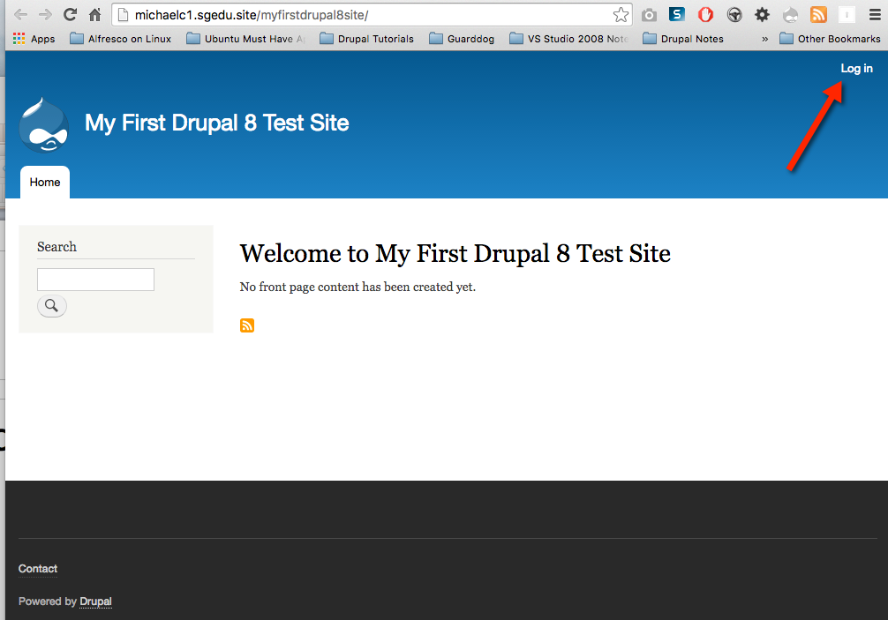
Drupal 8 – Front End – Login Upper Right

Slide 44
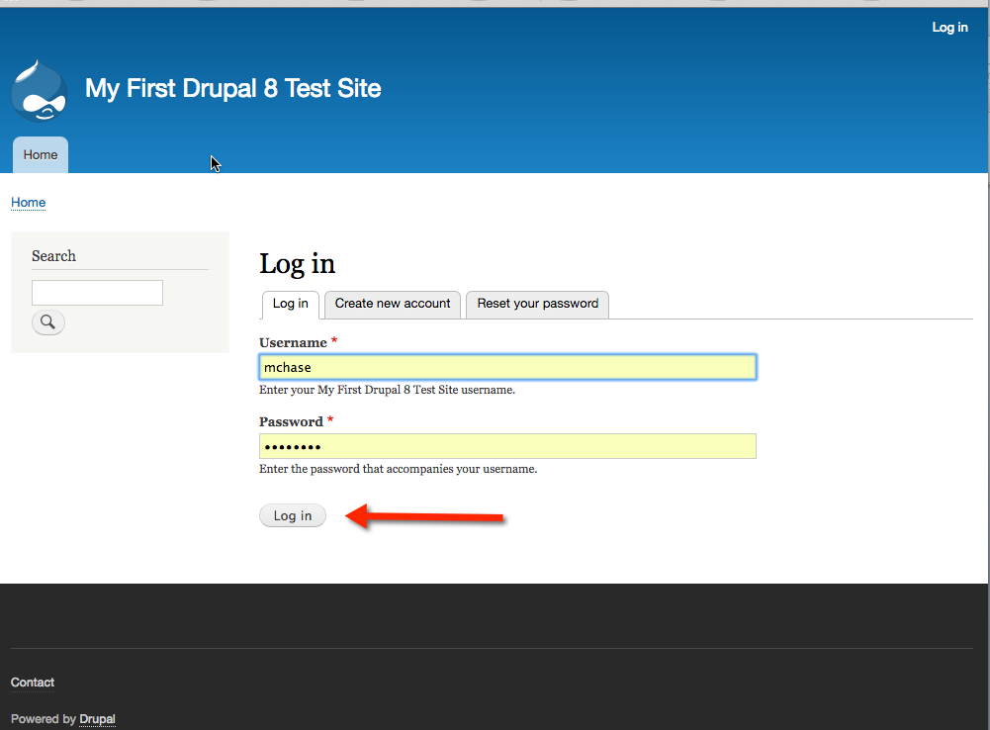
Login to Drupal 8 Site

Slide 45
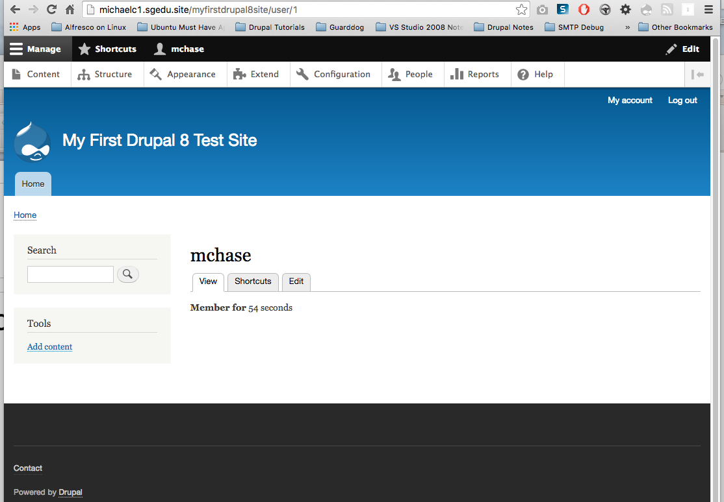
Drupal 8 Backend – Extended View Admin Menu Along Top

Slide 46
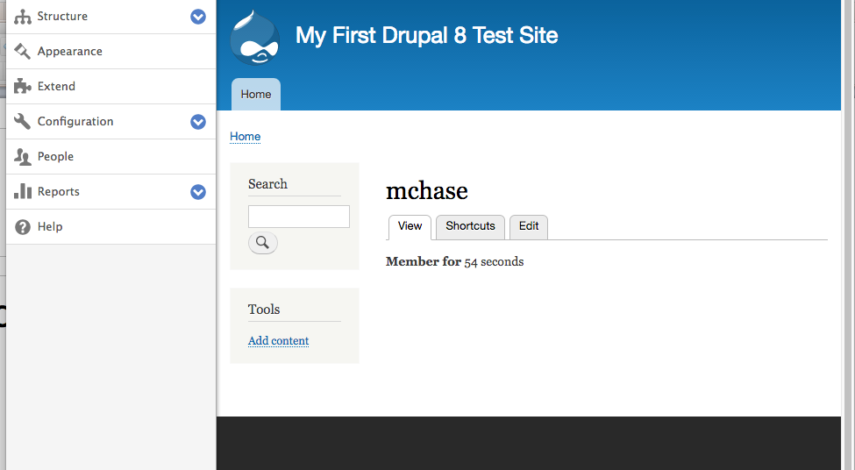
Drupal 8 – Compressed view – Admin menu along left side

Slide 47
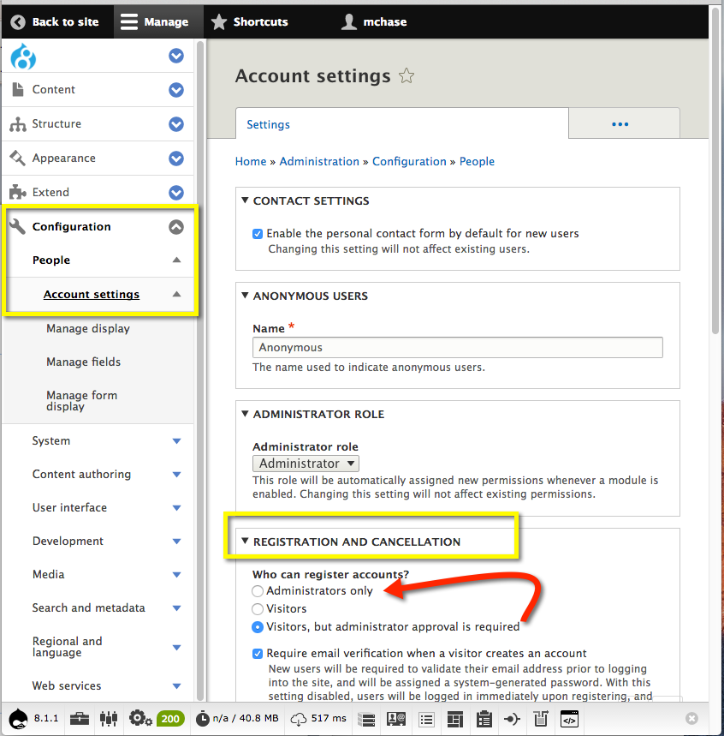
Immediately Harden the Drupal 8 site
Harden the Registration and Cancelation policy
Only allow Administrator accounts to register accounts

Slide 48
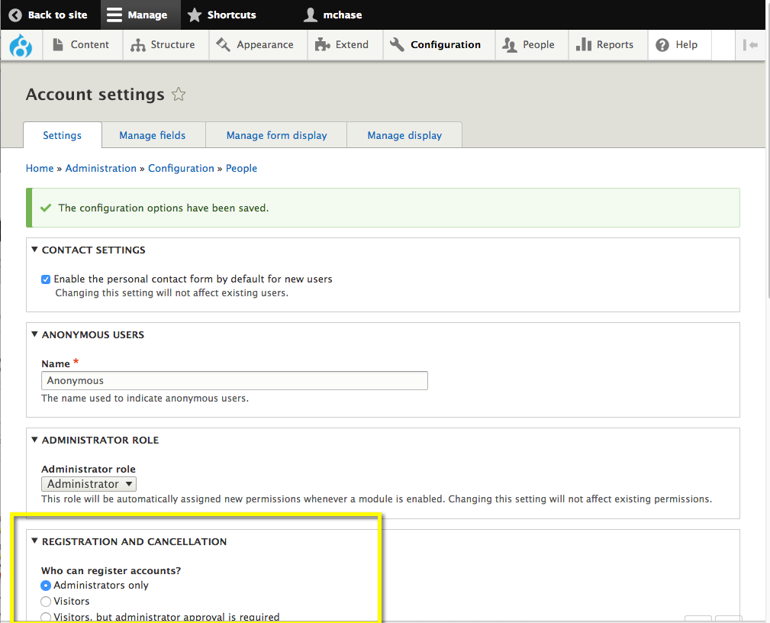
Registration and Cancelation updated

Slide 49
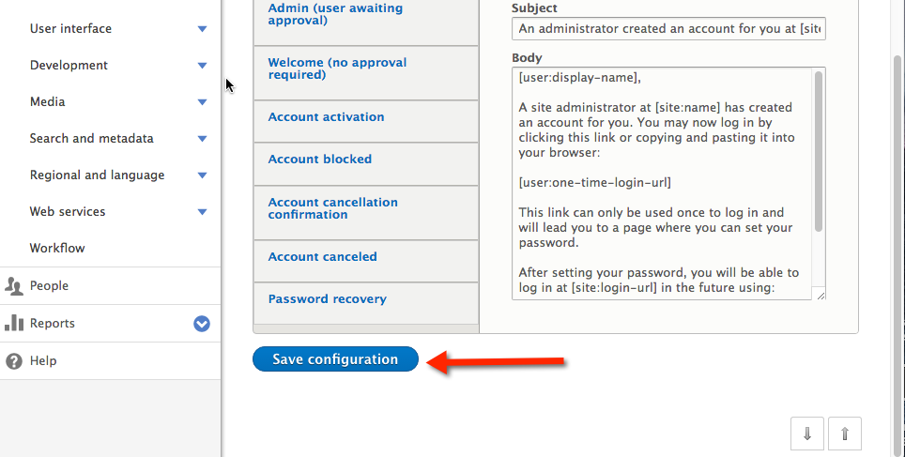
Scroll to the bottom of the page and save your changes

Slide 50
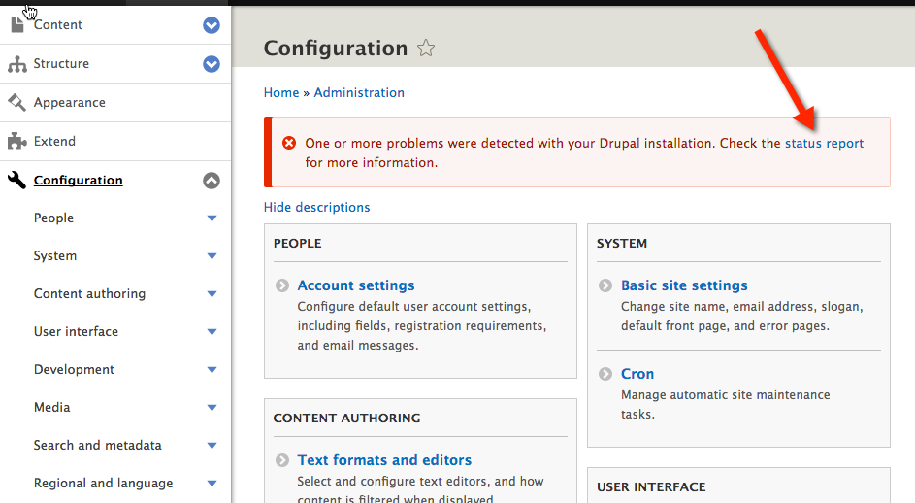
If you see the message about problems with your Drupal installation, select the link to navigate to the Status Report

Slide 51
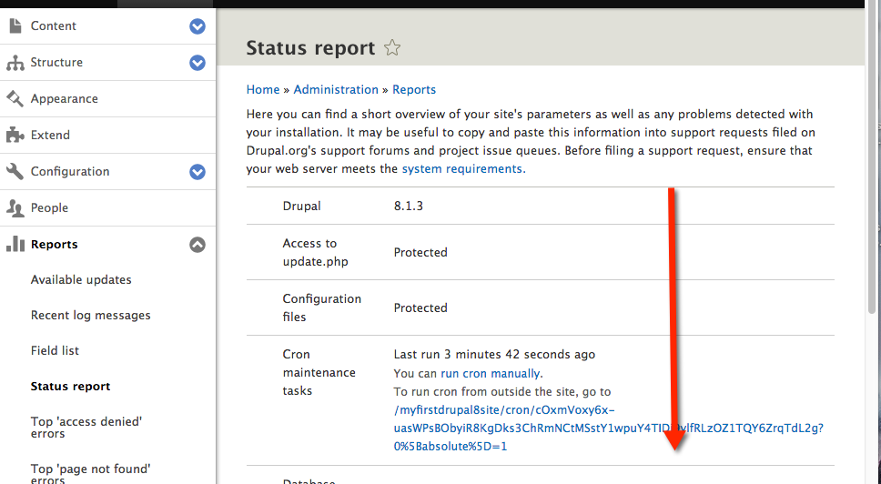
On the D8 Status report page, scroll down

Slide 52
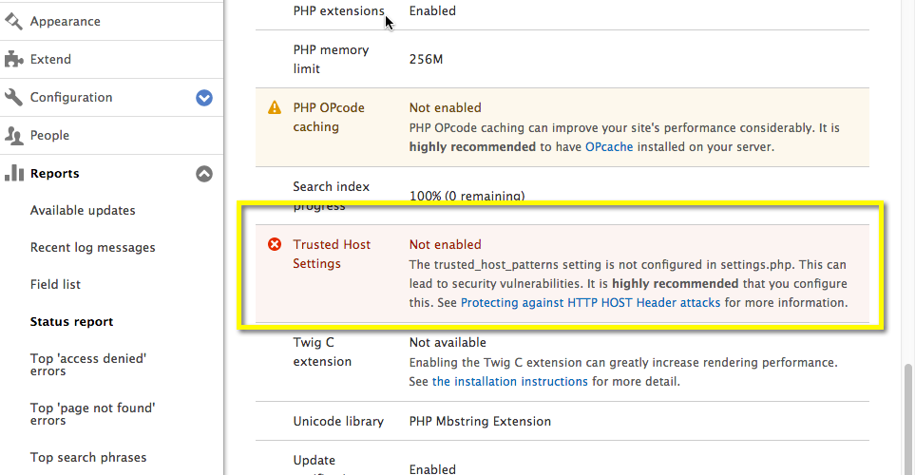
IF you see this Trust Host Settings Error Message – We need to fix it

Slide 53
Understanding the Trust Host Settings Error
Before we can fix the error, we have to understand its about.
According to the web page (whose link was listed in the Status report) this error is about protecting against HTTP Host Header attacks [https://www.drupal.org/node/1992030], this error can be fixed by editing the settings.php file:
As of January 2015, Drupal 8 supports "trusted host patterns", where you can (and should) specify a set of regular expressions that the domains on incoming requests must match. Example configuration in settings.php would read:
$settings['trusted_host_patterns'] = array(
'^www\.example\.com$',
);

Slide 54
Fixing the Drupal 8 (D8) Trust Error
Determine the correct trusted host pattern to use in the settings.php file – I asked SiteGround tech support for help
Edit the correct settings.php file (this has to be done for each D8 site you create)
There is already a commented out section in the settings.php for our new trusted host pattern code
Save the settings.php file and re-fresh the Drupal 8 Status report – verify the Trust error message no longer displays

Slide 55
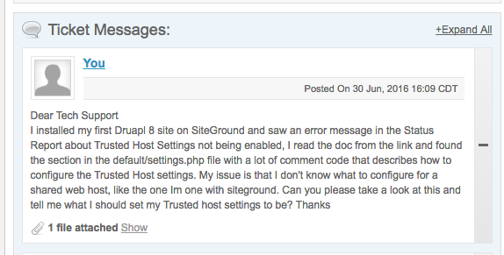
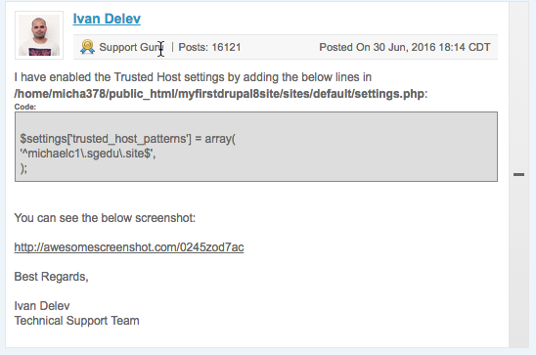
My SiteGround Support Ticket 630-2016 16:09 CDT
SiteGround Response 630-2016 18:14 CDT

Slide 56
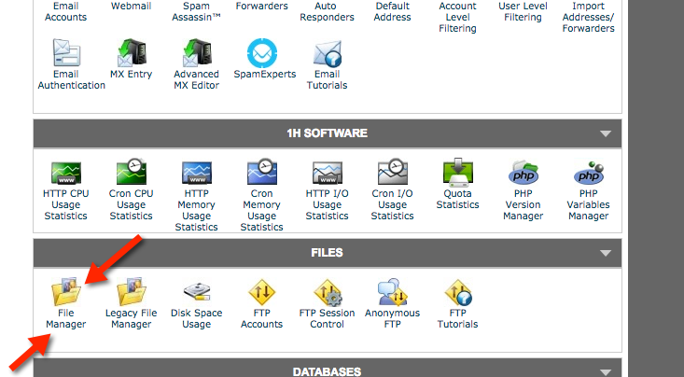
cPanel > FILES > File Manager

Slide 57
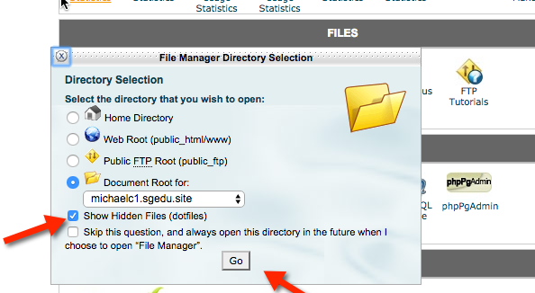
Please check the Show Hidden Files (dotfiles) and the press Go

Slide 58
Background before finding and editing the settings.php
Warning – Please backup the settings.php file before making any changes.
If you make a mistake to this file you will kill your Drupal site (as in dead and never coming back)

Slide 59
Background before finding and editing the settings.php
The settings.php file location depends on the type of Drupal 8 (D8) CMS site
If you built the Drupal 8 site as the web root site, in other words, you did not enter a sub directory path or an in directory path, the settings.php is located at public_html\sites\default\settings.php
If you created a sub directory or in directory site, then the settings.php is located in the created named directory. Example – In directory site named myfirstdruapl8site, Is located at public_html\myfirstdrupal8site\sites\default\settings.php

Slide 60
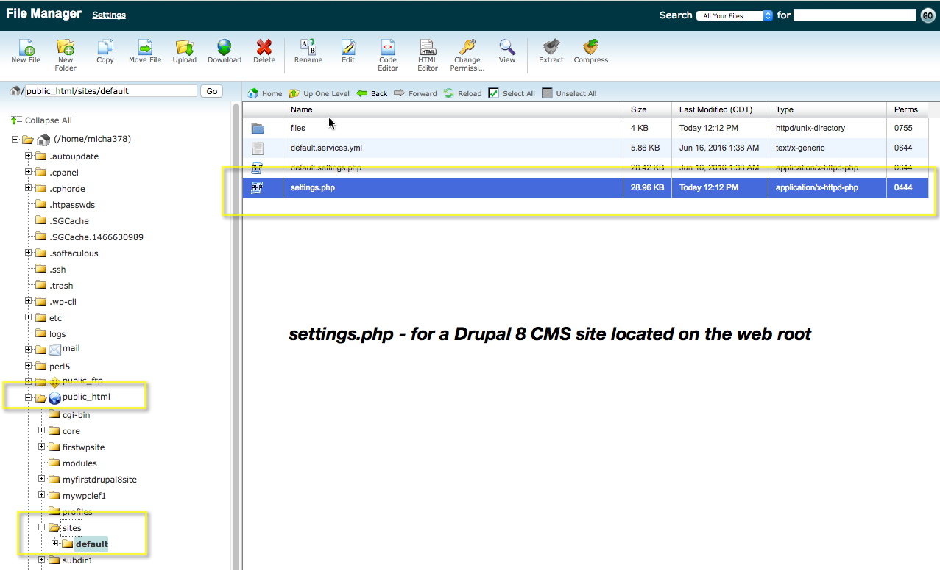
Drupal 8 site as the web root site

Slide 61
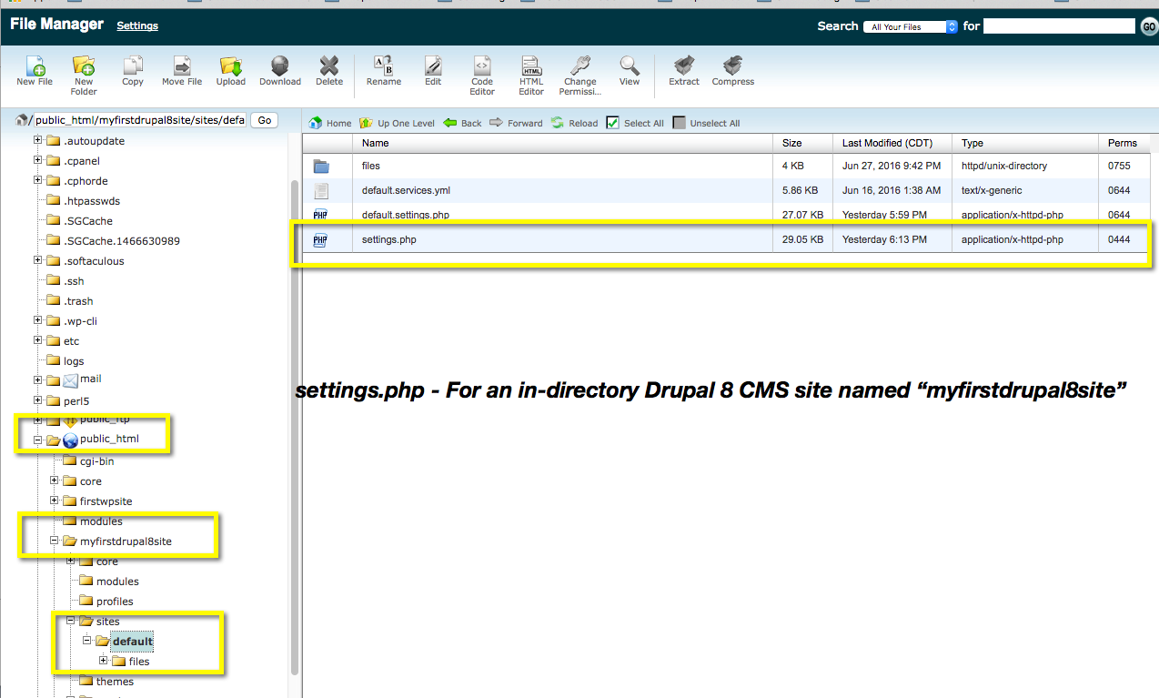
An In Directory Drupal 8 site

Slide 62
Folder and file permissions must both changed before you can edit the file
The settings.php file resides in the sites\default folder whose permissions are set at 0555
The default folder permission must be set to 0755 first. After editing the settings.php, the Drupal will set this back to 0555 automatically. Its kind of un-nerving.
The settings.php file has permissions of 0444.
You must set the file permissions to 755, then edit the file, adding the Trust permission code, then manually re-set the permissions back to 0444
Drupal will set the sites/default permissions back on its own. Best to check and make sure it happened.

Slide 63

Set Default permissions from 0555 to 0755

Slide 64

Example of clicking on Perms to reset the settings.php file permissions from 0444 → 0755

Slide 65

To EDIT the settings.php, select and right click and select Code Edit

Slide 66

settings.php Mods my domain is michaelc1.sgedu.site My trust array item value is ‘^michaelc1\.sgedu.\site$’

Slide 67

settings.php – code block for Trusted host configuration Lines 671 – 705 commented out

Slide 68

Re-fresh Status Report – Trusted Host Error id fixed

Slide 69

Fixing Trusted Host Error 2017 For an In-directory Site on CMS-Freelancers

Slide 70
Browsers For Managing Drupal Sites
Don’t use SAFARI or OPERA browsers when working on Drupal admin tasks
Firefox and Chrome are great for Drupal Admin work
Microsoft IE is pretty good
DO NOT USE OPERA or Safari when maintaining Drupal sites.
OPERA & Safari have cache issues that throw some bizarre error messages and mess up your site
I have had bad luck using Safari for Drupal management. These issues were not as bad as the ones I had with OPERA.

